Slide 1



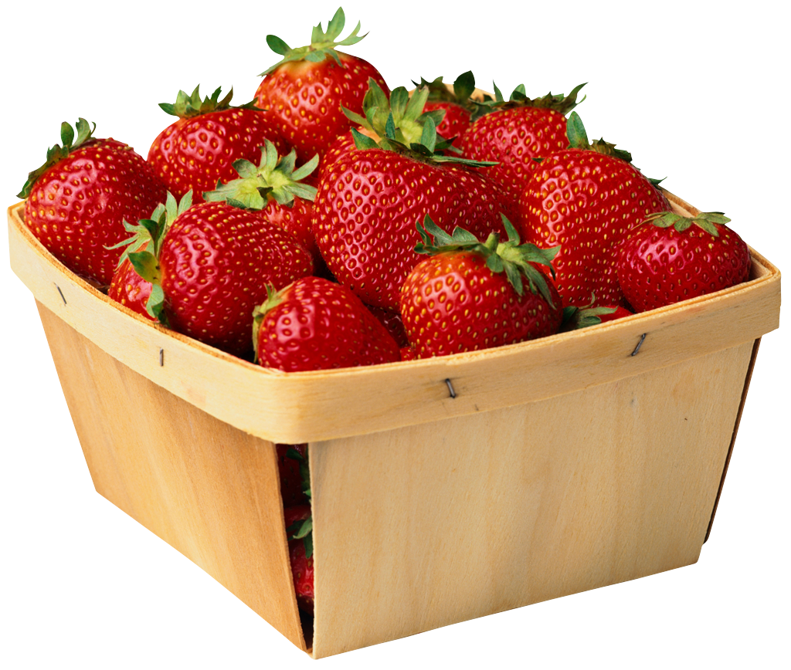
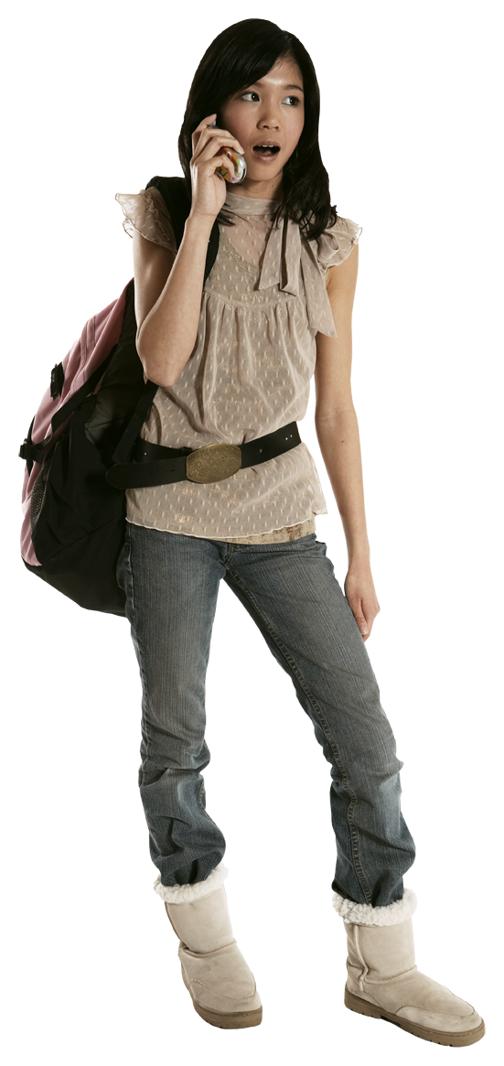
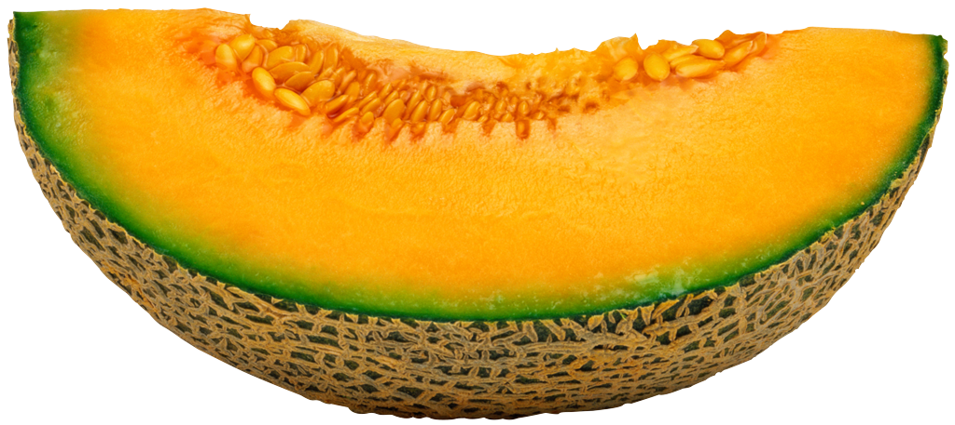


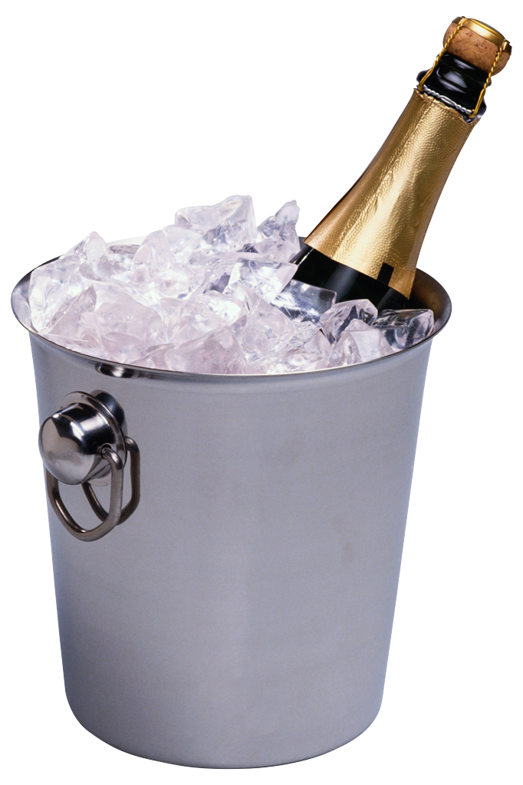
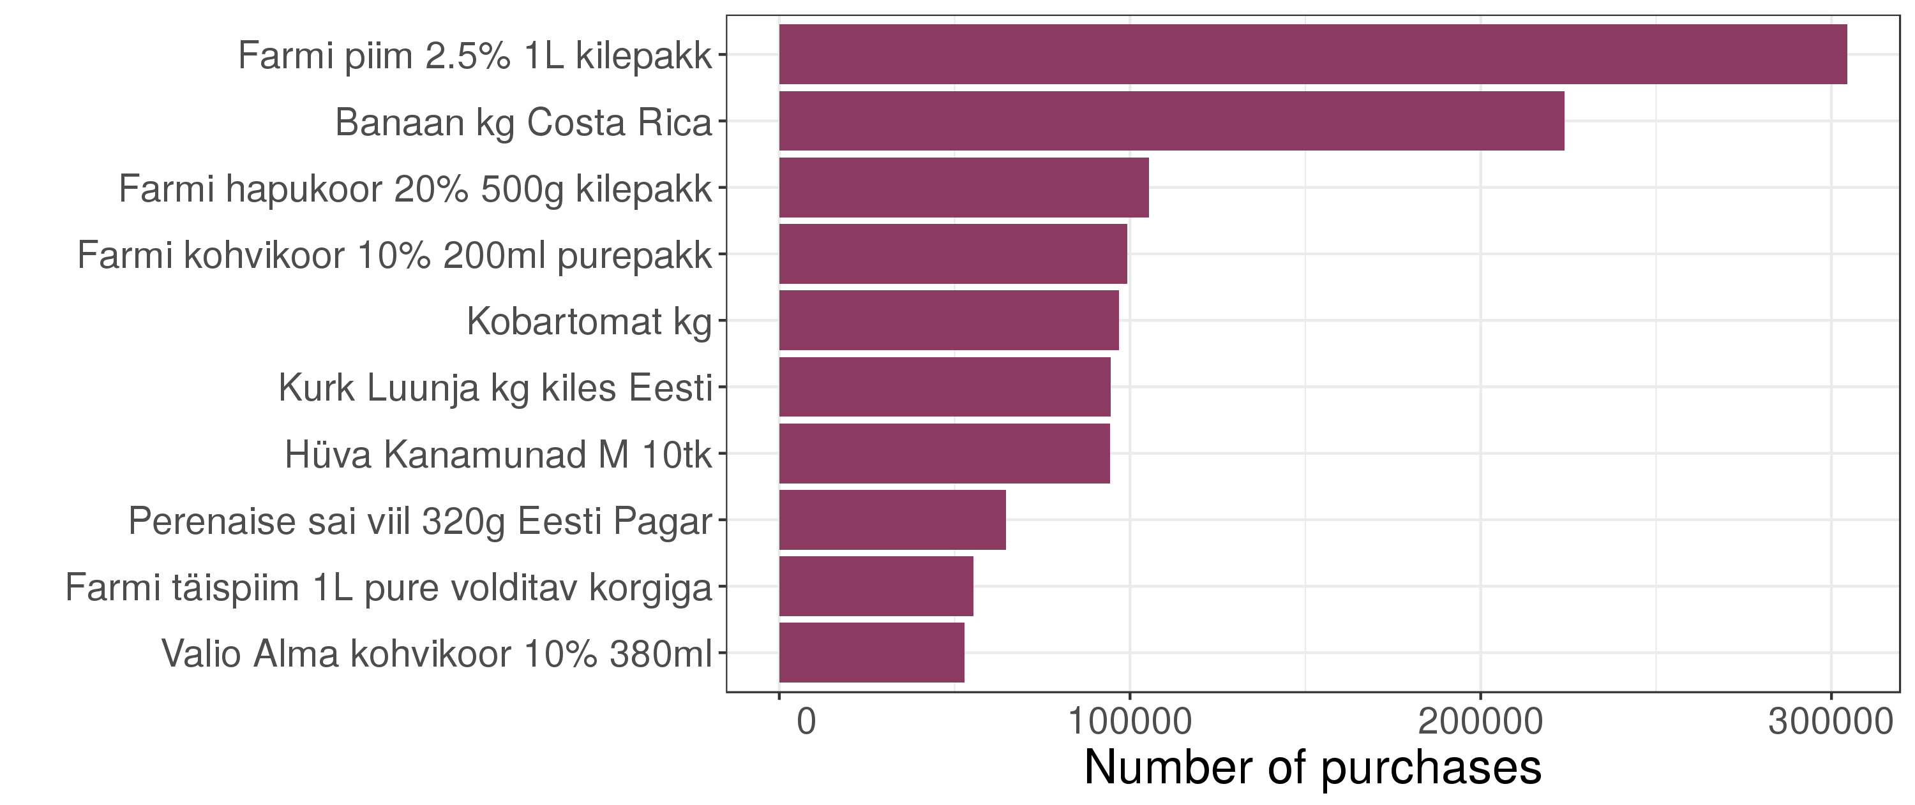
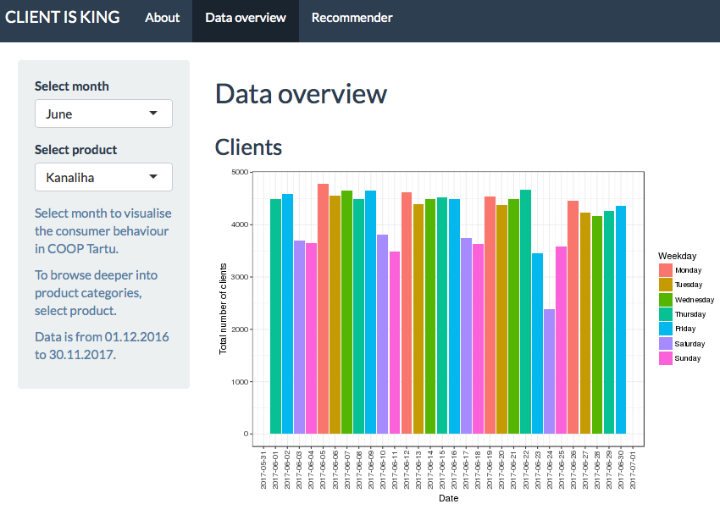
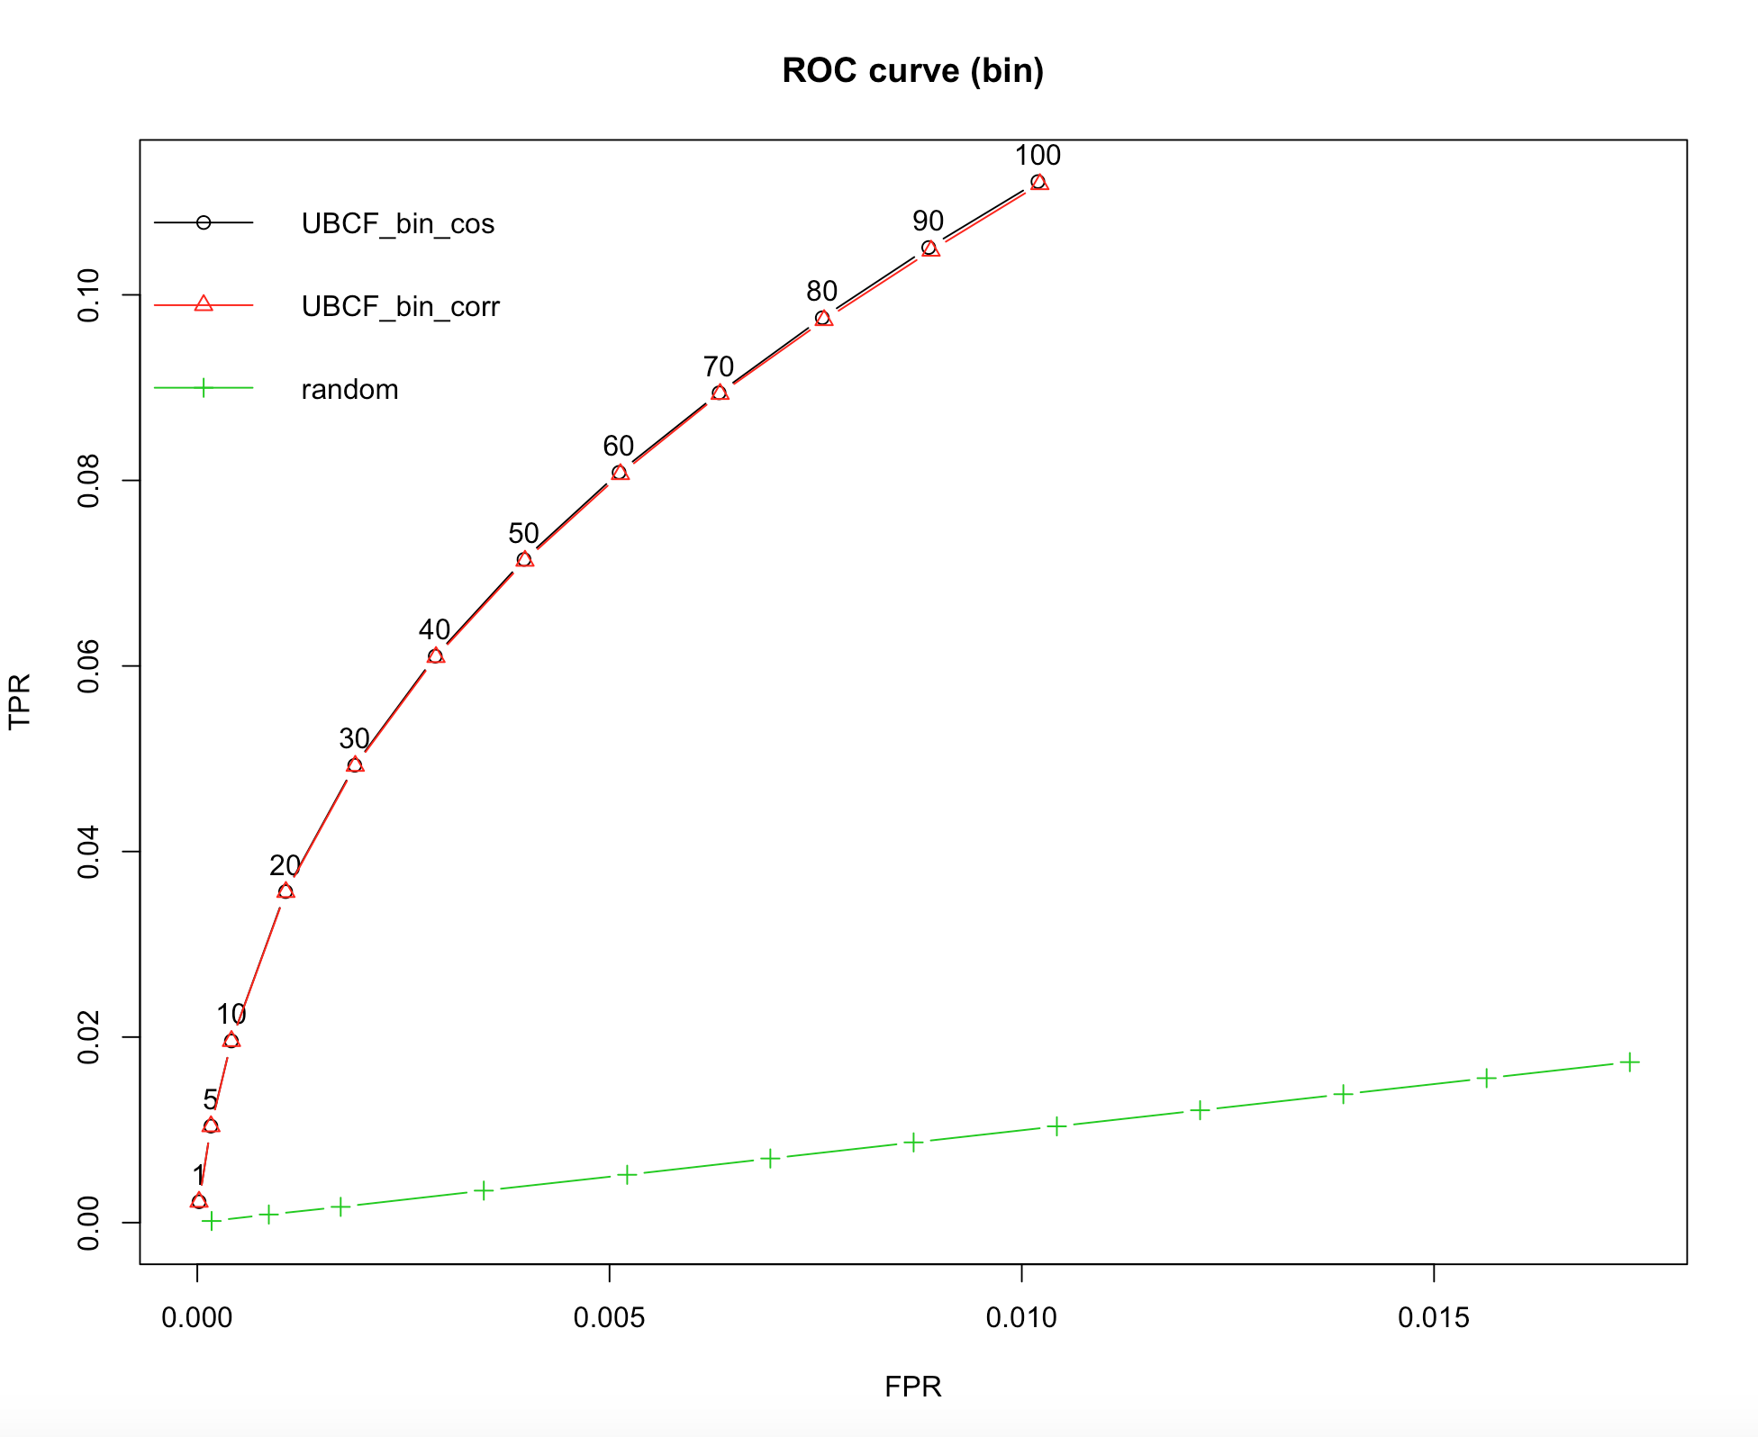
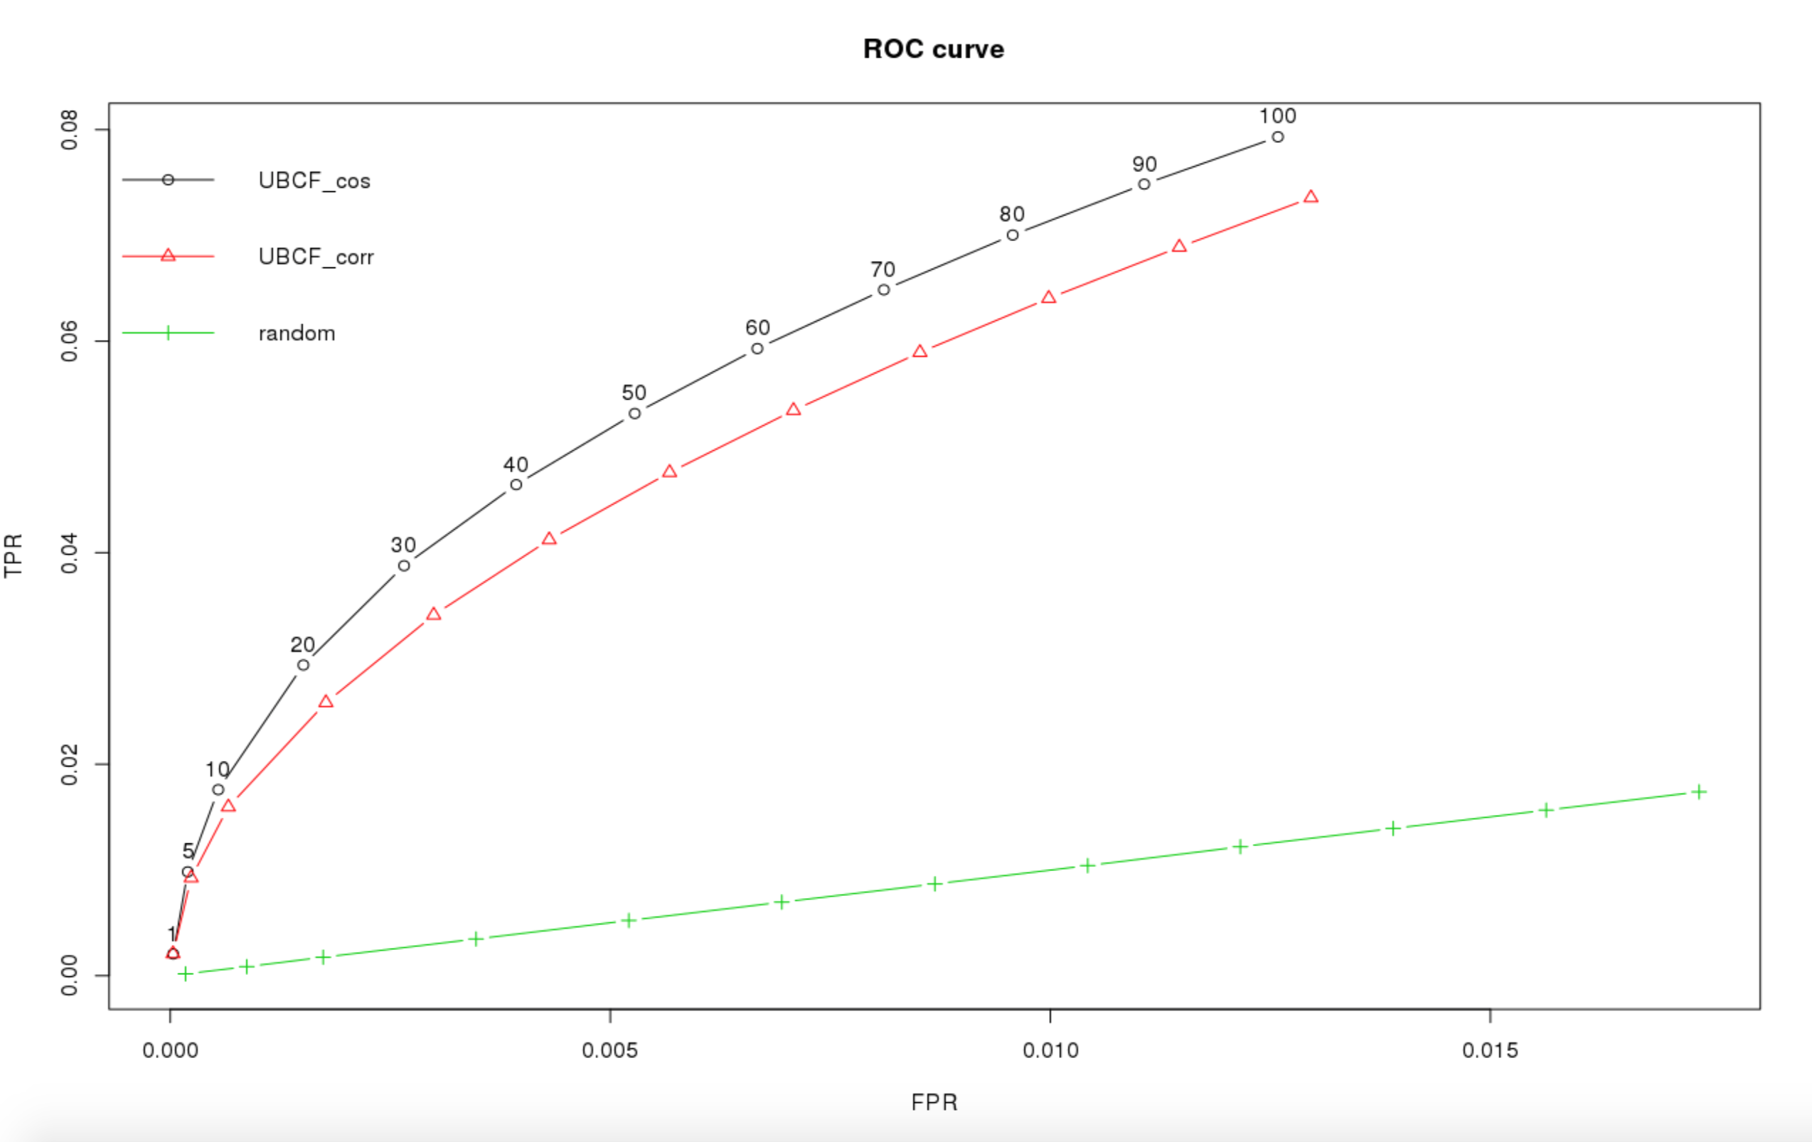
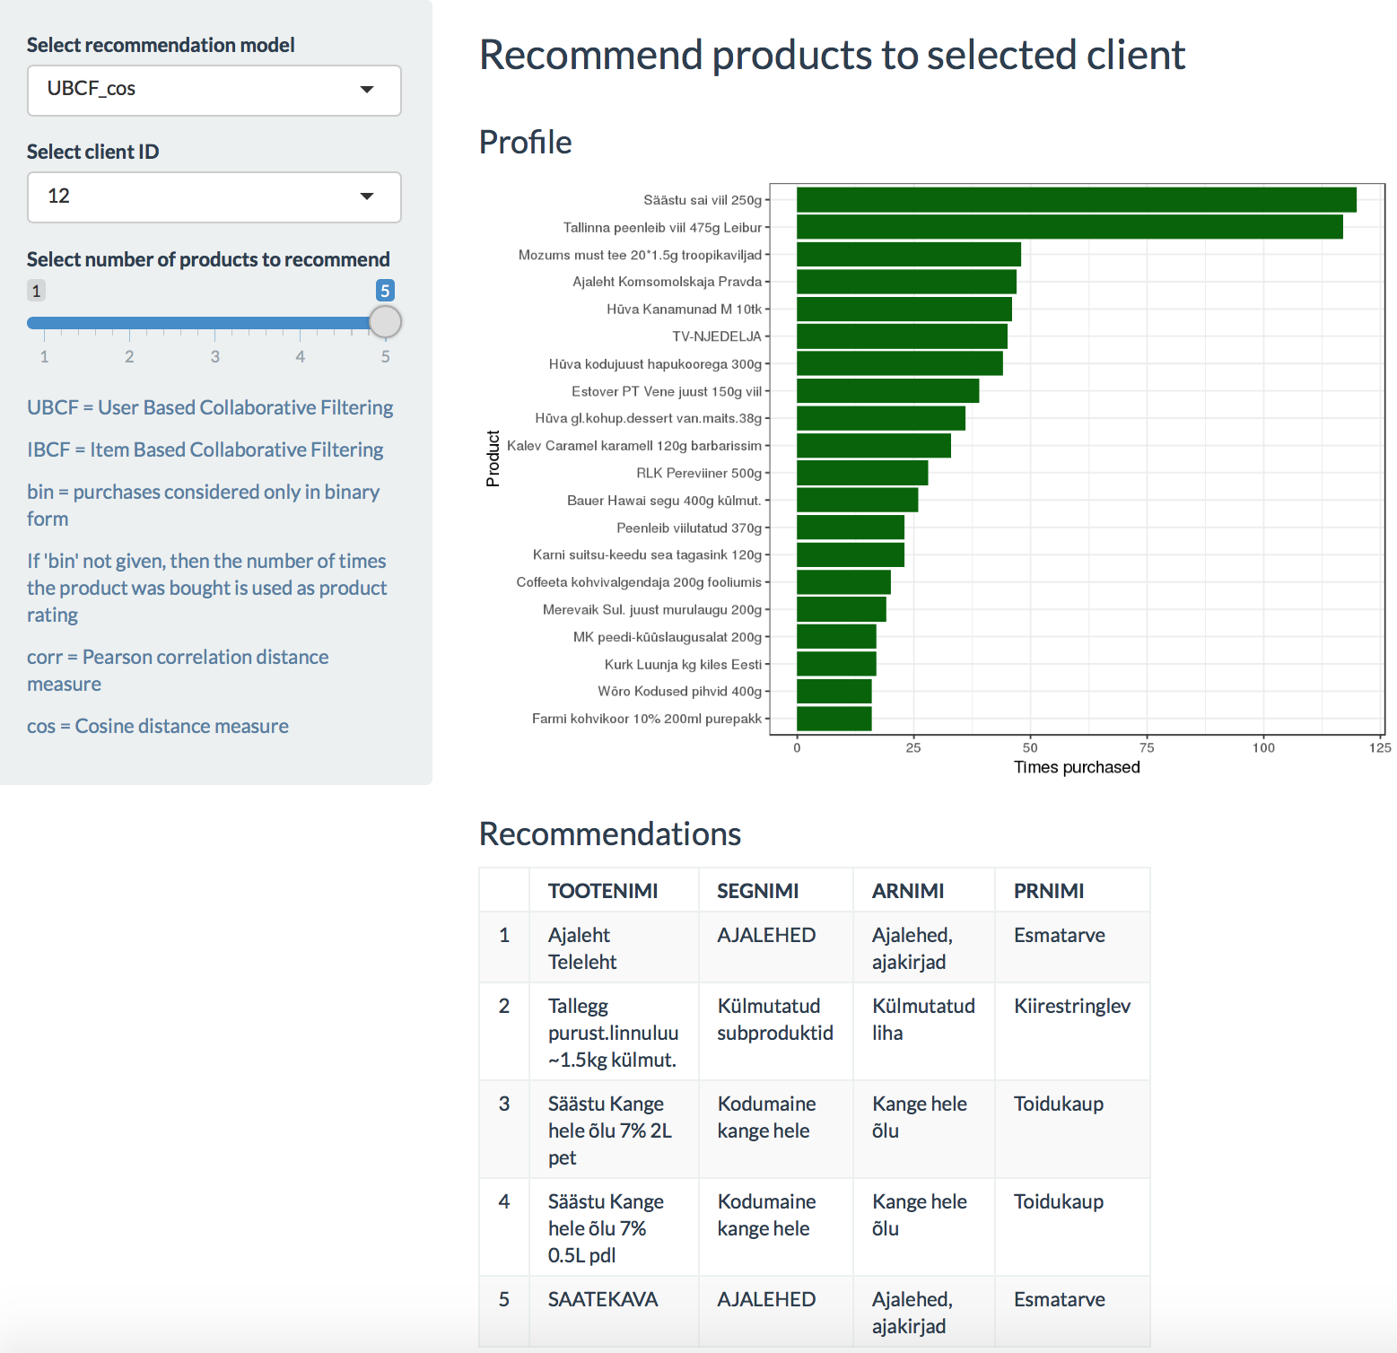
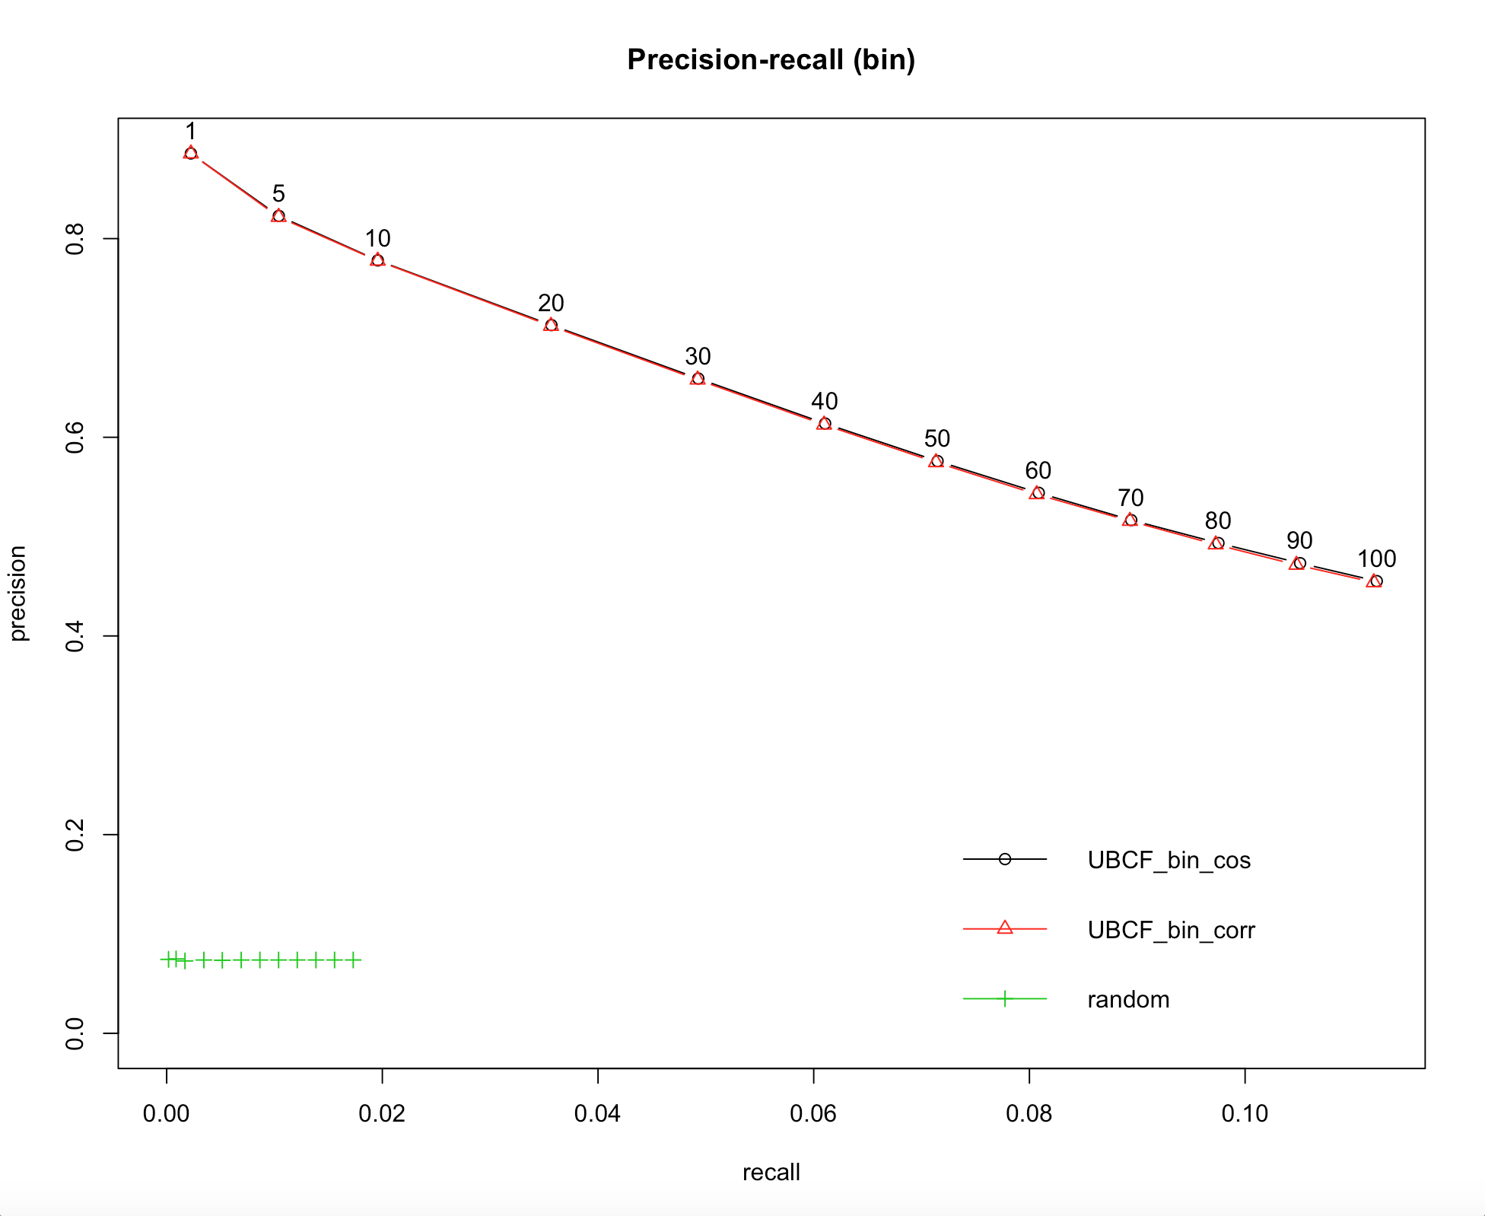
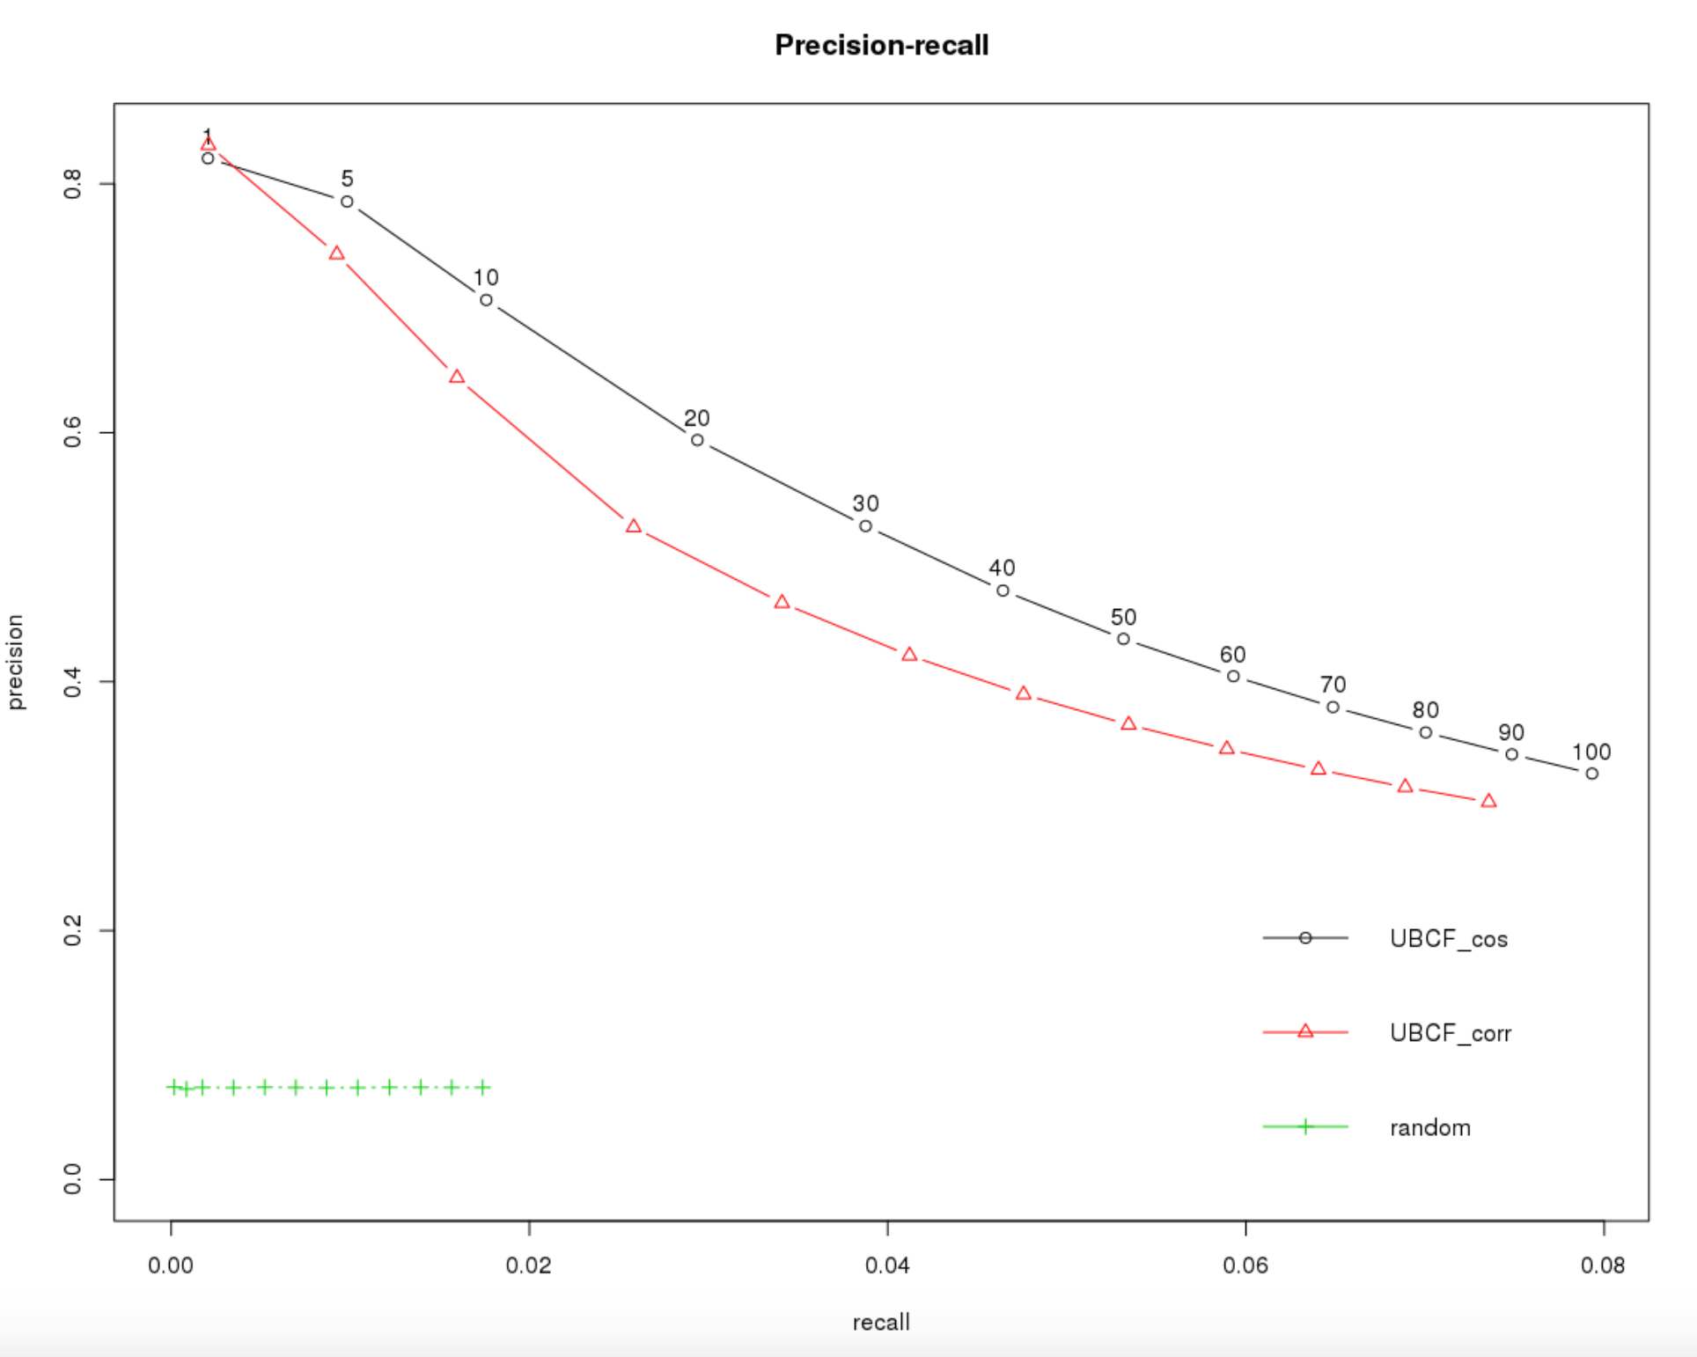
Recommendation system for COOP-Tartu
Ahto Salumets, Enn Pokk, Liis Kolberg Institute of Computer Science, University of Tartu
Collaborative filtering
User-based
Item-based
Similarity measures:
Pearson correlation
Cosine distance
Rating matrices:
Binary
Number of purchases as rating
Data
Most popular products
Sales data from COOP-Tartu stores in 01.12.2016 - 30.11.2017
Excluded:
Too frequent and infrequent clients (>365 purchases, <12 purchases)
Tobacco products
Products purchased <1000 times over a year
Used for recommendation models:
Categories: essential goods, food and fast-paced products
Top 10000 clients
Results
UBCF correlation & cosine
Binary rating
Nr of purchases
Prototype in Shiny
Source code: https://github.com/liiskolb/dm_project2017 References: 1. Gorakala, S.K., Usuelli, M., 2015. Building a recommendation system with R. Packt Publishing Ltd.
2. R package recommenderlab, http://s2.smu.edu/IDA/recommenderlab/

